Slide 1
Chapter 7
Network Layer – Part 2
(IP addressing)
Module 11: IPv4 Addressing Introduction to Networks v7.0 (ITN)

Slide 2
Objectives
7.1 IPv4 Addressing
7.2 IPv6 Addressing

Slide 3

7.1 IPv4 Addressing
Each device on a network must be uniquely defined by 32-bit / 4 OCTETS IPv4 address regardless it is in the same network or different networks.
IP address is unique and used universally to define the connection of a host or router to the Internet.
Unique : one and only one identifier
Universal : The addressing system is accepted in the Internet world

Slide 4
Cont’d…
IPv4 address in 32-bit format is not easy to remember. Hence, it is represented in 4 segments of decimal number, separated by dots “.”
192.168.1.1
Decimal form
11000000 10101000 00000001 00000001
4 Octets with no “.”
Binary form

Slide 5
Number Conversion
Decimal → Binary (division method)
64 to binary ? 0100 00002
Binary → Decimal (multiply with the weight)
1100 00112 to decimal ? 195

Slide 6
Cont’d…
1 | 1 | 0 | 0 | 0 | 0 | 1 | 1
128
64
32
16
8
4
2
1
2⁷
2⁶
2⁵
2⁴
2³
2²
2¹
2⁰
1*2⁷
+
1*2⁶
+
1*2¹
+
1*2⁰
= 128 + 64 + 2 + 1
= 195

Slide 7
Exercise
192.172.1.3 → 32-bit binary format
11000000 10101100 00000001 00000011 (division method)
11111111 00000000 11110000 00001111
→ 4 segments decimal format
255.0.240.15 (multiply with the weight)

Slide 8
Some commonly used notations
0000 0000 → 0
1000 0000 → 128
1100 0000 → 192
1110 0000 → 224
1111 0000 → 240
1111 1111 → 255

Slide 9
Structure of IPv4
IPv4 provide hierarchical addressing for packets that carry data.
The 32 bits IPv4 address is made up of two parts: a network portion and a host portion.
This segregation is what makes IPv4 addresses hierarchical structured addresses.

Slide 10
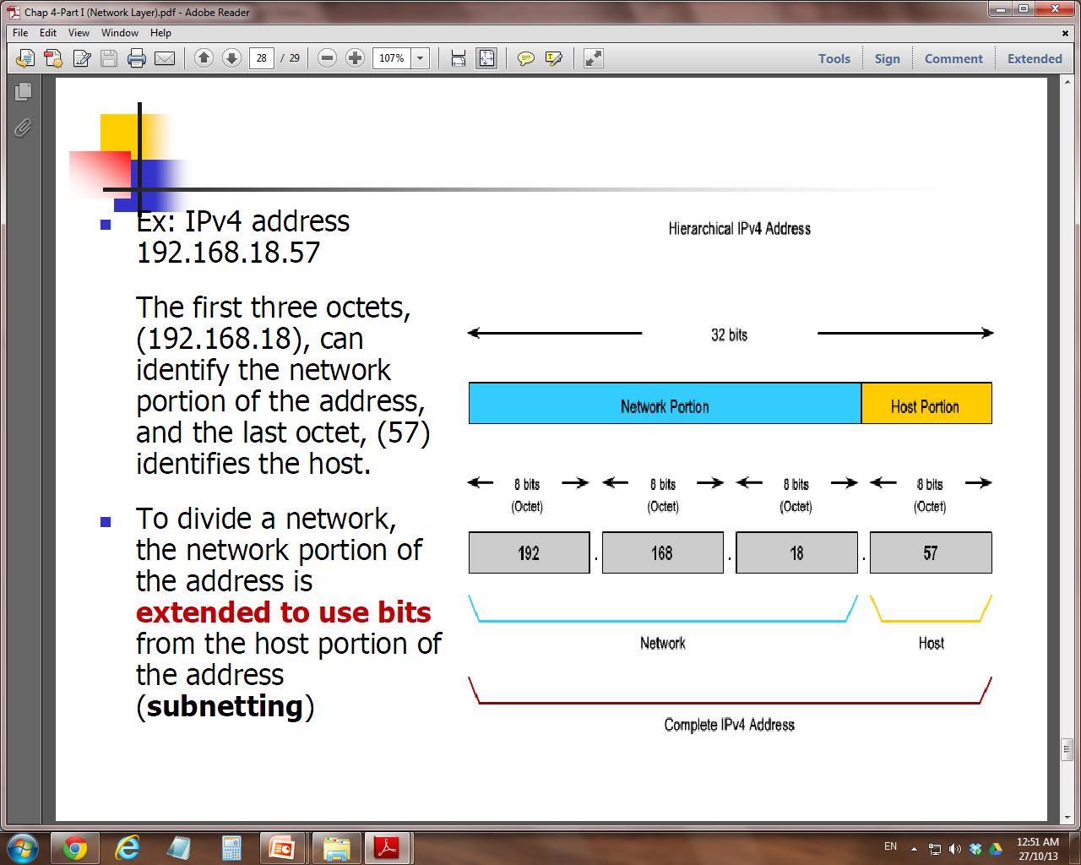
Cont’d…
Eg. 192.168.18.57
The first three octets (192.168.18) can be used to identify the network and the last octet (57) can be used to identify the host.
The network portion of address can also be extended to use the BITS in the host portion of address → Subnetting (next week)

Slide 11
IPv4 Subnet Mask
How are we going to know which portion (how many bits) of the 32-bits is the network and which is the host?
This is done by comparing the IP address with the Subnet Mask
Subnet Mask is a separated 32-bit pattern that is used to identify the network and host portions of a given IPv4 address

Slide 12
Cont’d…
When an IP host is configured, a subnet mask is assigned along with an IP address.
The subnet mask signifies which part of the IP address is network and which part is host.
“1” in the subnet mask represent the network portion
“0” in the subnet mask represent the host portion
The subnet mask TOGETHER with IPv4 address are required for a host to determine which network it belongs to.

Slide 13
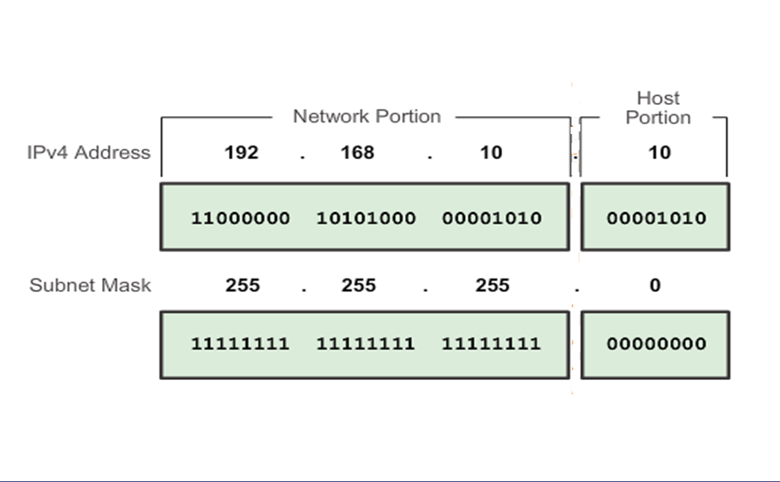
24 bits for network address
8 bits for host address

Slide 14
Exercise
IPv4 Address | 172.16.4.1
Subnet Mask | 255.255.255.0
IPv4 Address in binary
Subnet Mask in binary?
How many bits for Network Address?
How many bits for Host Address?
10101100 00010000 00000100 00000001
11111111 11111111 11111111 00000000
24 bits
8 bits
IPv4 Address | 172.16.4.1
Subnet Mask | 255.255.128.0
IPv4 Address in binary
Subnet Mask in binary?
How many bits for Network Address?
How many bits for Host Address?
10101100 00010000 00000100 00000001
11111111 11111111 10000000 00000000
17 bits
15 bits

Slide 15
Cont’d…
The prefix length is another way of expressing the subnet mask.
It shows the number of bits set to 1 in the subnet mask by using “slash notation ( / )”.
Eg.
Subnet mask = 255.255.255.0 (decimal dotted format)
= 11111111.11111111.11111111.00000000
→ 24 “1” bits
→ prefix length = /24
→ 24 bits of IP address are used for network portion /
the remaining 8 bits are used for host portion

Slide 16
Type of addresses in a network
There are 3 major types of addresses within the address range of each IPv4 network:
Network address*
An address that is used to identify a network (HOST PORTION will be
ALL “0”) – first address of a network, not assignable
Host address
An address which is used to identify a host in a network
(host portion will consist of “0” and “1”)
Broadcast address*
A special address used to send data to all hosts in a network (HOST
PORTION will be ALL “1”) – last address of a network, not assignable

Slide 17
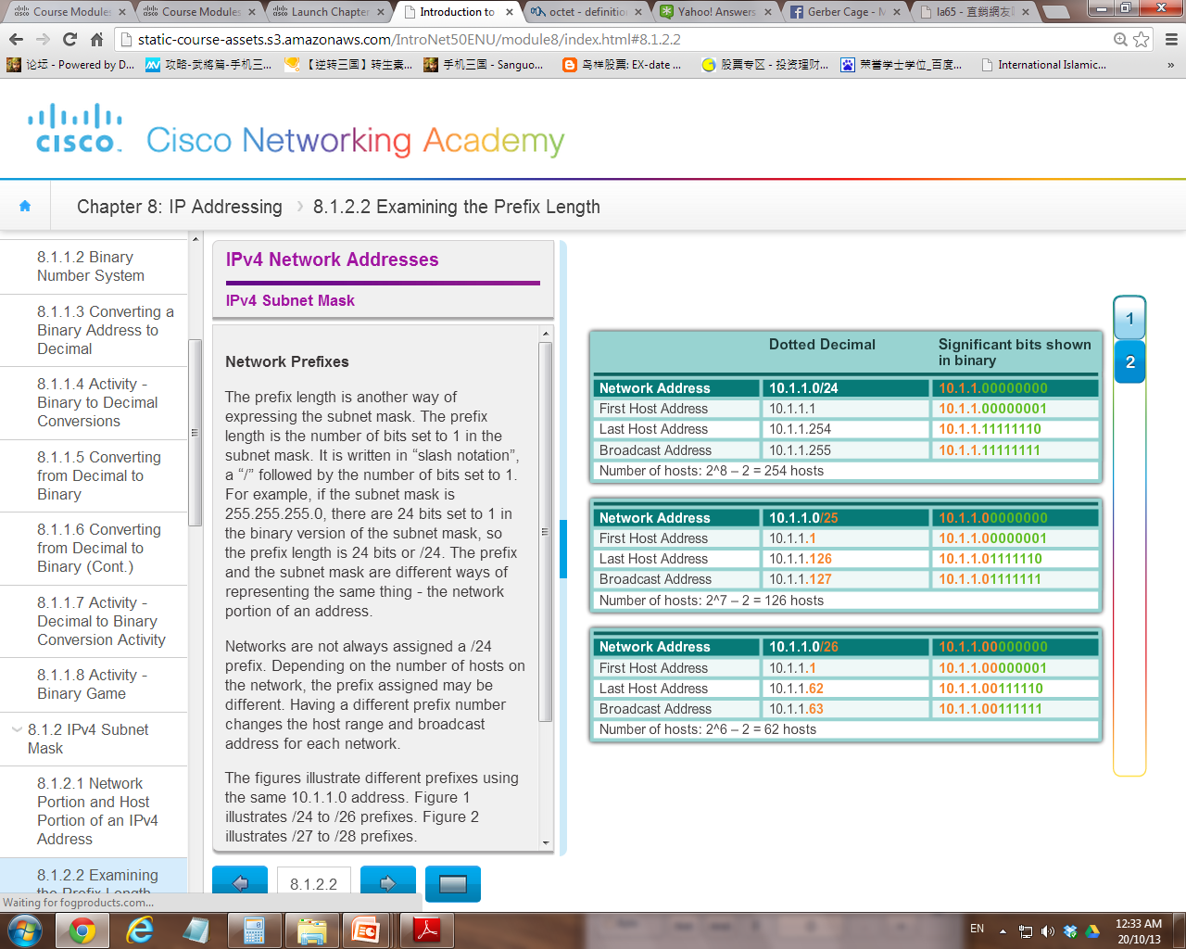
network
host
Usable IP

Slide 18
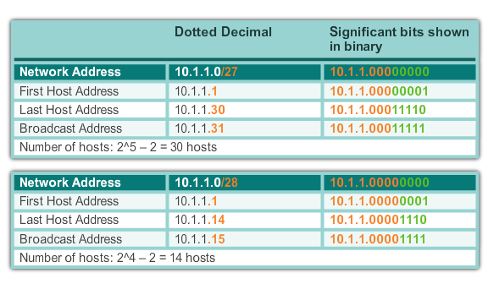

Slide 19
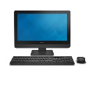
Exercise
110.112.1.0/26
Max 62 hosts
Given a network 110.112.1.0/26
Calculate:
bits for network portion :
bits for host portion :
host addresses range :
broadcast address :
no. of hosts :
01101110 01110000 00000001 00000000
26
6
110.112.1.1 – 110.112.1.62
110.112.1.63 (x.x.x.00111111)
2⁶ - 2 = 64 – 2 = 62

Slide 20
Exercise
209.165.200.224 /30
Max 2 hosts
Given a network 209.165.200.224/30
Calculate:
bits for network portion :
bits for host portion :
host addresses range :
broadcast address :
no. of hosts :
11010001.10100101.11001000.11100000
30
2
209.165.200.225 – 209.165.200.226
209.165.200.227
(x.x.x.11100011)
2² - 2 = 4 – 2 = 2

Slide 21
Determining Network Address
Given a host IPv4 address 192.168.10.10, which network does this IP belong to?
???
192.168.10.10

Slide 22
Bitwise AND Operation
When an IPv4 address is assigned to a device, that device uses the Subnet Mask to determine which network the device belongs to.
So when a host send data it can decide how a packet should be send (send directly or go through the gateway)
How to use Subnet Mask to find the network address immediately?

Slide 23
Cont’d…
The AND operator is used in determining the network address (which network the host belongs to)
1 AND 1 = 1
0 AND 1 = 0
0 AND 0 = 0
1 AND 0 = 0
The IPv4 host address is logically ANDed, bit by bit, with its subnet mask to determine the network address to which the host is associated.
When both are “1” then “1”, else “0”

Slide 24
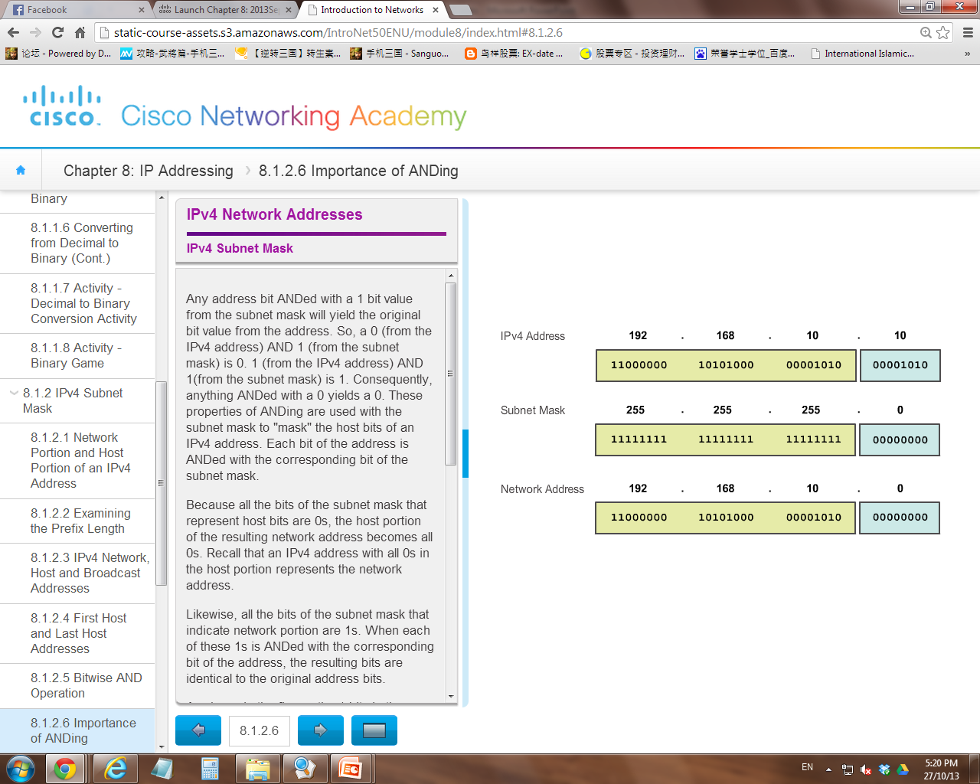
The AND operation
Which network do I belong to?
AND operation
192.168.10.10 belongs to network 192.168.10.0

Slide 25
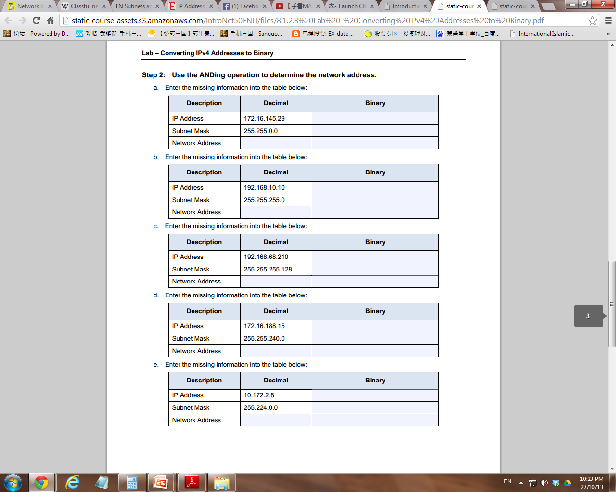
Exercise
10101100 00010000 10010001 00011101
11111111 11111111 00000000 00000000
172.16.0.0
10101100 00010000 00000000 00000000
11000000 10101000 00001010 00001010
11111111 11111111 11111111 00000000
192.168.10.0
11000000 10101000 00001010 00000000

Slide 26
Unicast, Multicast, Broadcast
In an IPv4 network, the hosts can communicate one of three ways:
Unicast - The process of sending a packet from one host to an individual host
Broadcast - The process of sending a packet from one host to ALL hosts in the network
Multicast - The process of sending a packet from one host to a SELECTED group of hosts, possibly in different networks

Slide 27
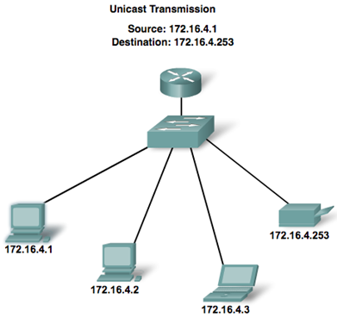
Unicast Transmission

Slide 28
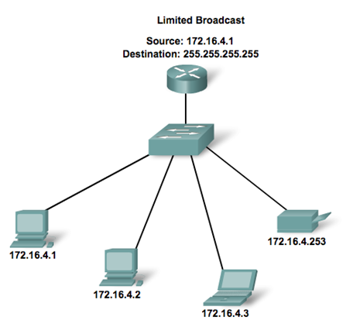
Broadcast Transmission

Slide 29
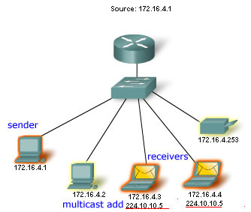
Multicast Transmission
Multicast clients need to subscribe to a multicast group using multicast address (224.0.0.0 to 239.255.255.255)

Slide 30
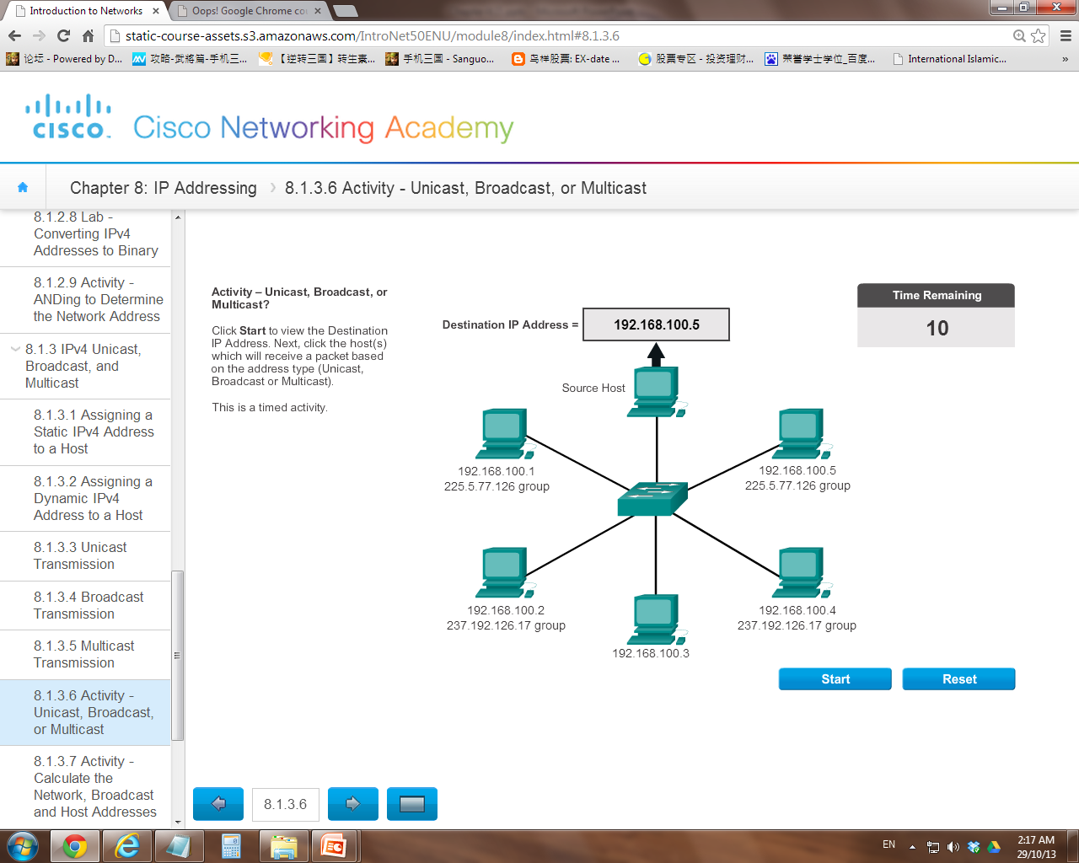
Exercise (Communication Mode)

Slide 31
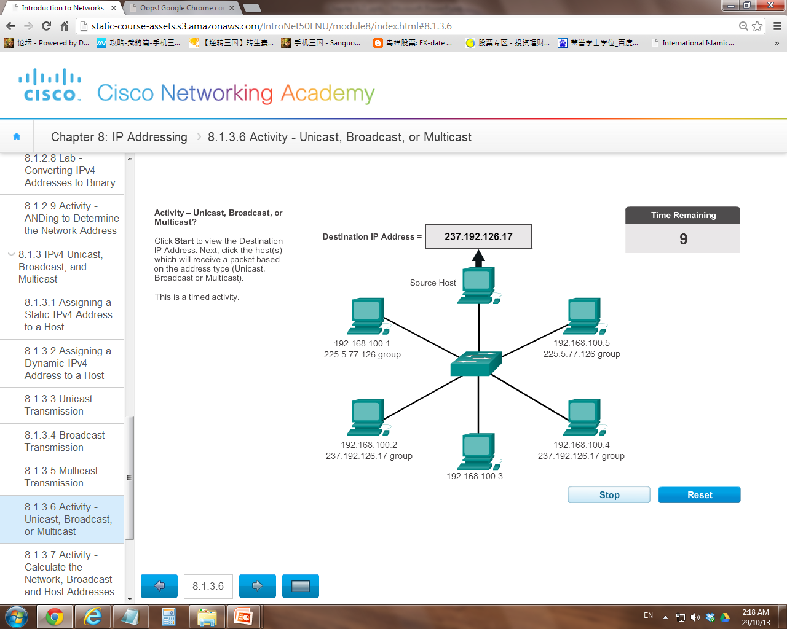

Slide 32
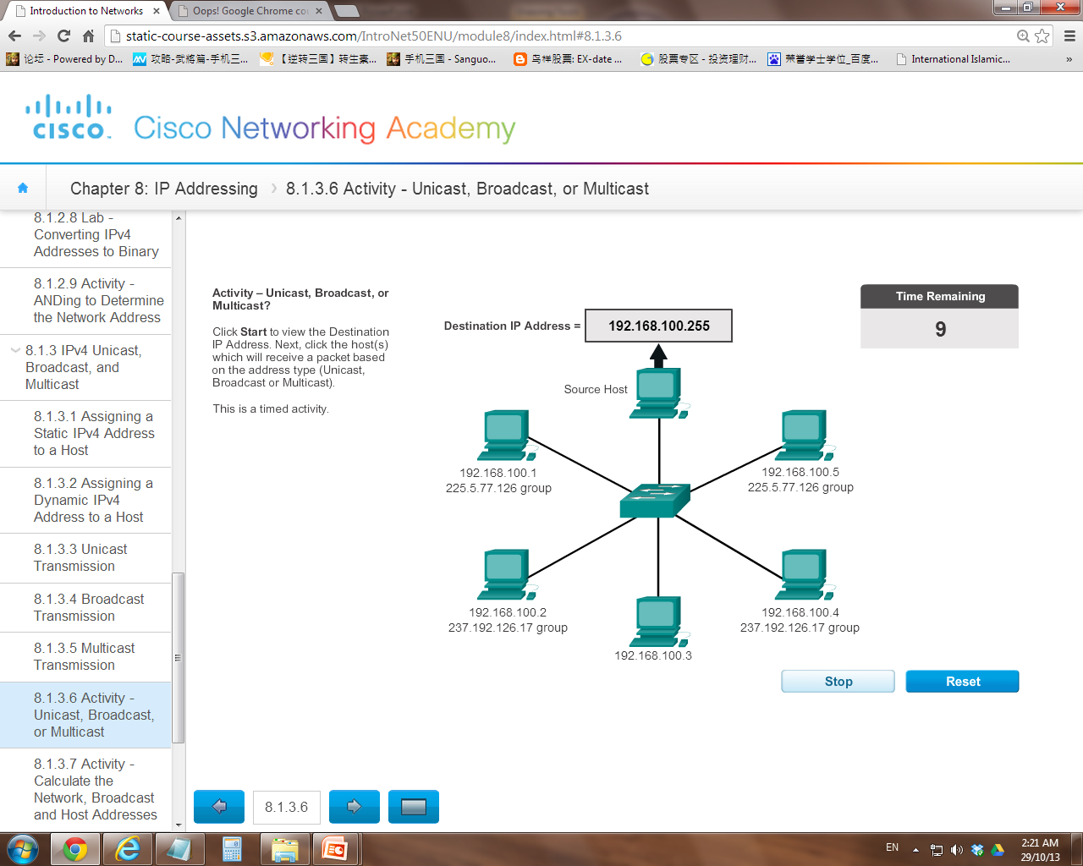

Slide 33
Types of IPv4 Addresses
Public IP addresses
Private IP addresses
Special IP addresses

Slide 34
Public vs Private IPv4 address
Public Addresses
Unique IP Addresses that are designed to be used in the hosts that are publicly accessible from the Internet.
External IP that is globally routable

Slide 35
Cont’d…
Private Address
IP addresses that require limited or no Internet access.
They are usually used in private network (internal IP)
The private address blocks are:
10.0.0.0 to 10.255.255.255 (10.0.0.0/8) Class A
172.16.0.0 to 172.31.255.255 (172.16.0.0/12) Class B
192.168.0.0 to 192.168.255.255 (192.168.0.0/16) Class C

Slide 36
Cont’d…
Private IP addresses can be duplicated in different networks.
Packets using these addresses as the source or destination should not appear on the public Internet.
The router or firewall device of the network will block or translate (NAT) these addresses → non-routable addresses

Slide 37
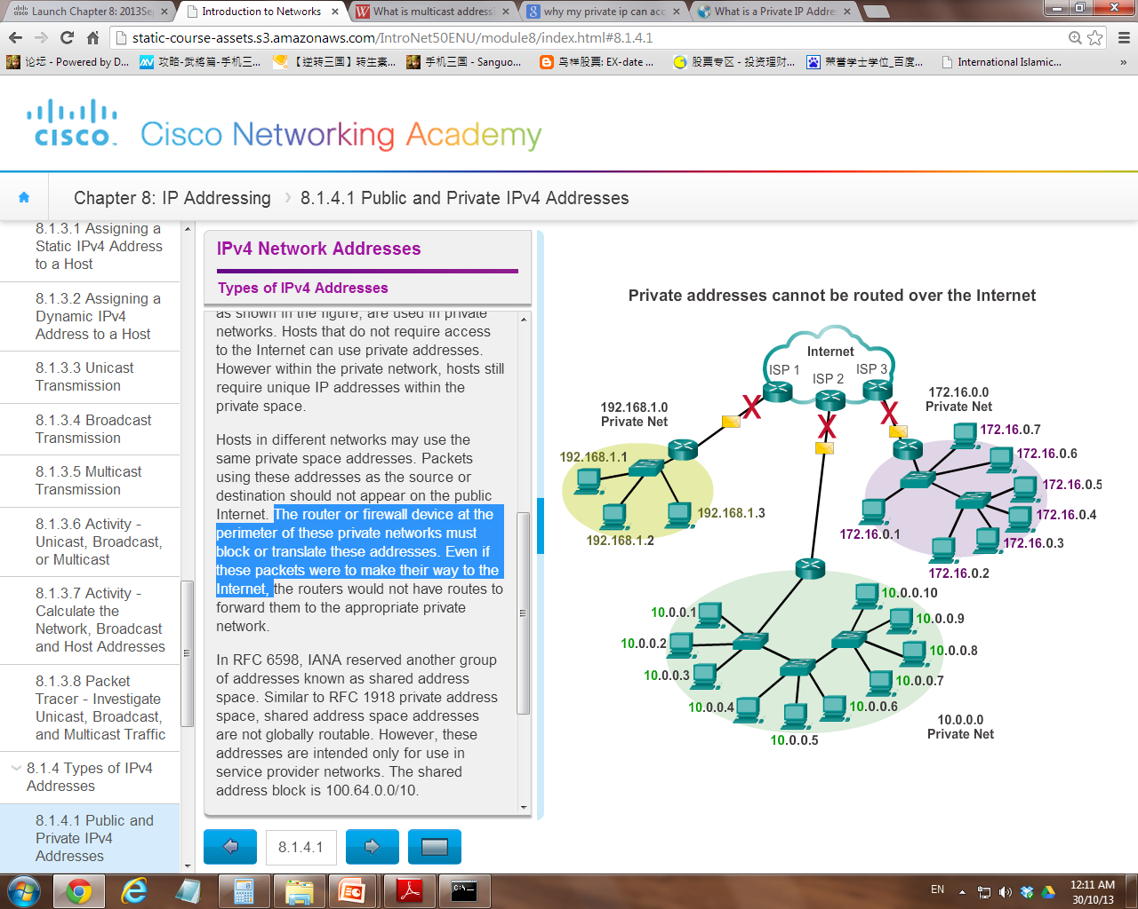

Slide 38
Special IPv4 Address
There are certain addresses that cannot be assigned to hosts. (non-usable IP)
Network and Broadcast Addresses
Default route
Loopback
Link-Local Addresses
TEST-NET Addresses

Slide 39
Network and Broadcast Addresses
First and last addresses of a network cannot be assigned to hosts.
Eg. 192.168.1.0 /24 (network address)
192.168.1.255 /24 (broadcast address)

Slide 40
Default route
A packet forwarding route that will be used when no other matched routes can be found in a routing table
0.0.0.0 /0
The address is non-routable on the global internet

Slide 41
Loopback
A special address that hosts use to direct traffic to itself (ping itself)
Usually use for testing the TCP/IP configuration whether it is operational
127.0.0.1 to 127.255.255.254 (127.0.0.0 /8)
The address is non-routable on the global internet

Slide 42
Link-Local Addresses
Addresses that can be automatically assigned to the local host (self-assigned) by the operating system when service of DHCP is absent
Aka Automatic Private IP Addressing (APIPA)
169.254.0.1 to 169.254.255.254 (169.254.0.0 /16)
The address is non-routable on the global internet

Slide 43
TEST-NET Addresses
Set aside for teaching and learning purposes.
192.0.2.0 to 192.0.2.255 (192.0.2.0/24)
The address is non-routable on the global internet

Slide 44
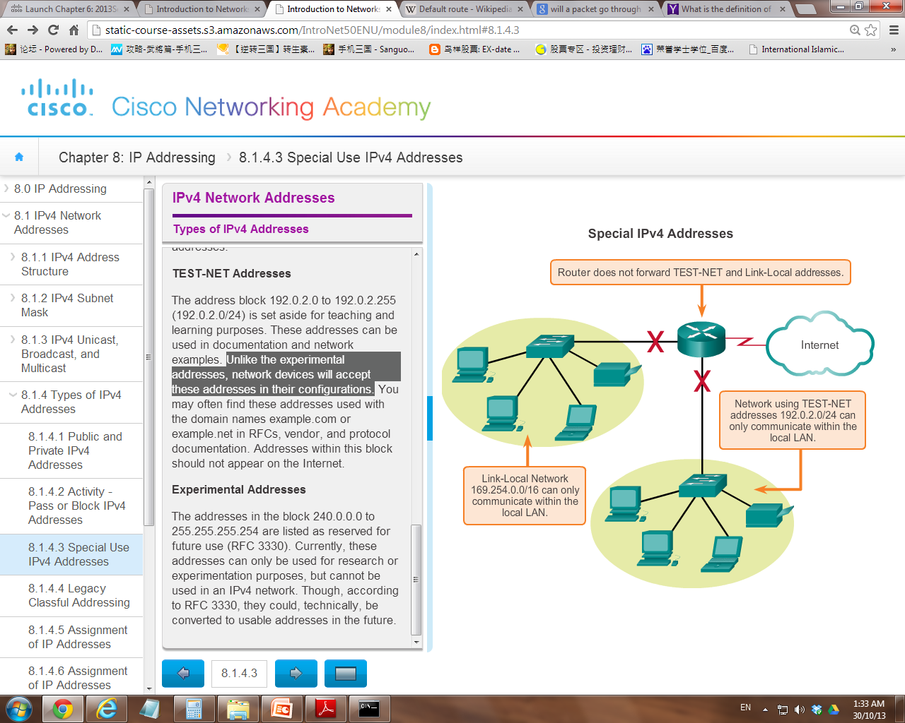

Slide 45
Types of Networks
Depending on the size of the network, IP-based networks are initially (abandoned in the late 1990s and replaced by classless addressing) divided into five classes (classful addressing).
Class A
Class B
Class C
Class D (multicast) and E (for experimental)

Slide 46
Class A networks
Class A networks are mega monster networks with up to 16 million plus nodes.
It uses fixed /8 prefix to indicate the network address.
The most significant bit of the high-order octet must be a “0”.
0nnnnnnn.hhhhhhhh.hhhhhhhh.hhhhhhhh
This meant that there were only 128 possible class A networks, 0.0.0.0/8 to 127.0.0.0/8
(why is it 16 millions plus nodes ?)
(why is it 128 class A networks only? )

Slide 47
Cont’d…
Only large organizations such as the military, government agencies, universities, and large corporations are assigned with class A addresses.

Slide 48
Class B networks
Class B networks are smaller networks in comparison because they can have only about 65,000 nodes.
It uses the two high-order octets (/16 prefix) to indicate the network address.
For class B addresses, the most significant two bits of the high-order octet were “10”.
10nnnnnn.nnnnnnnn.hhhhhhhh.hhhhhhhh
Network addresses will range from 128.0.0.0/16 to 191.255.0.0/16. (>16k Class B networks)
(why is it 65k nodes ?)
(why is it >16k networks ?)

Slide 49
Cont’d…
Class B addresses are assigned to large organizations including corporations (such as Cisco, government agencies, and school districts).

Slide 50
Class C networks
These are the baby networks that can have only 254 nodes (2⁸) at the maximum
Class C address blocks used a /24 prefix (how many octet?) to indicate the network address.
For Class C addresses, the most significant three bits of the high-order octet were “110”.
110nnnnn.nnnnnnnn.nnnnnnnn.hhhhhhhh
This restricted the address block for class C from 192.0.0.0/24 to 223.255.255.0/24. (> 2millions Class C networks)
(why is it 254 nodes ?)
(why is it >2m networks ?)

Slide 51
Cont’d…
The number of IP addresses in class C is smaller than the needs of most organizations.
…. but is too big for small business or household that needs only a small amount of IP addresses.

Slide 52
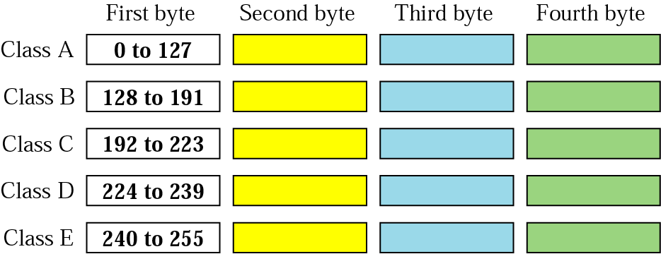
Exercise
Determine the network class of the following addresses:
(1) 00000001 00001011 00001011 11101111
(2) 11010011 10011011 11111011 00001111
(3) 10000000 00000001 11111100 11111111
(4) 227.12.14.87
(5) 134.11.255.13

Slide 53
Subnet Mask
Although classful addressing has been abandoned but the operating system still make the default subnet mask assignment base on the class of the network.
Class | Prefix | Subnet Mask (D) | Subnet Mask (B)
A | /8 | 255.0.0.0 | 11111111.00000000.00000000.0000000
B | /16 | 255.255.0.0 | 11111111.11111111.00000000.00000000
C | /24 | 255.255.255.0 | 11111111.11111111.11111111.00000000
Note: In mask, binary “1” represents network portion, and binary “0” represents host portion.

Slide 54
Exercise
IPv4 Address | Class | Default Mask | Network Address
198.162.1.3
1.12.100.31
172.30.77.5
Class C
255.255.255.0
192.168.1.0
Class A
255.0.0.0
1.0.0.0
Class B
255.255.0.0
172.30.0.0

Slide 55
Limitation of Class-based System
Classful allocation of address space often wasted many addresses, which exhausted the availability of IPv4 addresses.
Eg: A company that had a network with 260 hosts would need to be given a class B address with more than 65,000 addresses.
No medium size host networks

Slide 56
Assignment of IP Addresses
Both IPv4 and IPv6 addresses are managed by the Internet Assigned Numbers Authority (IANA)
The IANA manages and allocates blocks of IP addresses to the Regional Internet Registries (RIRs) eg. ARIN, APNIC, RIPE
RIRs are responsible for allocating IP addresses to ISPs who in turn provide IPv4 address blocks to organizations and smaller ISPs.

Slide 57
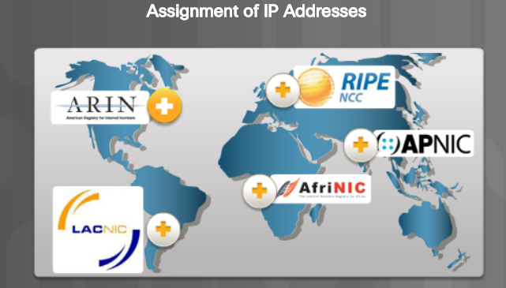
Europe, Middle East, Centre Asia
North America
Asia and Pacific
Latin America & Caribbean Islands
Africa

Slide 58
7.2 IPv6 Addressing
Projections show that IPv4 addresses will be depleted between 2015 and 2020.
With an increasing Internet population, a limited IPv4 address space and Internet of Everything (IOT), the time has come to begin the transition to IPv6.
IPv6 is designed to be the successor to IPv4.
There is not a single date to move to IPv6.
For the foreseeable future, both IPv4 and IPv6 will coexist. The transition is expected to take years.

Slide 59
IPv4 and IPv6 Coexistence
The migration techniques can be divided into three categories:
Dual Stack
Tunneling
Translation

Slide 60
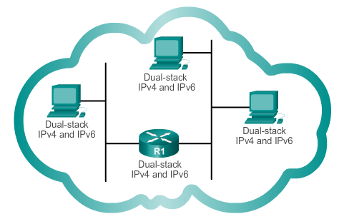
Dual Stack
Allows IPv4 and IPv6 to coexist on the same network. Devices run both IPv4 and IPv6 protocol stacks simultaneously.

Slide 61
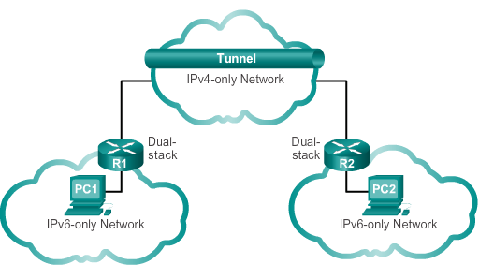
Tunneling
A method of transporting an IPv6 packet over an IPv4 network. The IPv6 packet is encapsulated inside an IPv4 packet.

Slide 62
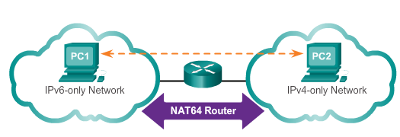
Translation
Network Address Translation 64 (NAT64) allows IPv6-enabled devices to communicate with IPv4-enabled devices using a translation technique similar to NAT for IPv4. An IPv6 packet is translated to an IPv4 packet, and vice versa.

Slide 63
IPv6 Address Representation
128 bits in length and written as a string of hexadecimal values
4 bits represents a single hexadecimal digit.
IPv6 has 32 hexadecimal values, represented in 8 hextet.
2001:0DB8:0000:1111:0000:0000:0000:0200
FE80:0000:0000:0000:0123:4567:89AB:CDEF
Can be written in either lowercase or uppercase
To increase readability, IPv6 is usually represented in compressed (shorten) form

Slide 64

Rule 1- Omitting Leading 0s
Any leading 0s (zeros) in the hextet can be omitted
01AB can be represented as 1AB
09F0 can be represented as 9F0
0A00 can be represented as A00
00AB can be represented as AB

Slide 65
Rule 2- Omitting All 0 Segments
A double colon (::) can replace any single, contiguous string of one or more hextets consisting of all 0’s
Double colon (::) can only be used once within an address otherwise the address will be ambiguous

Slide 66
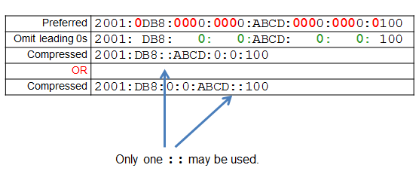
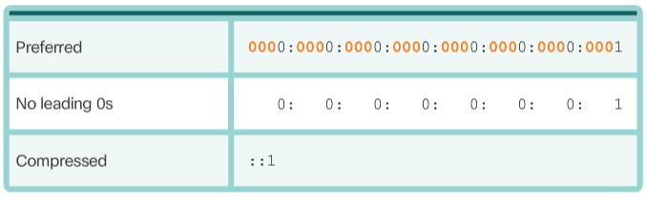
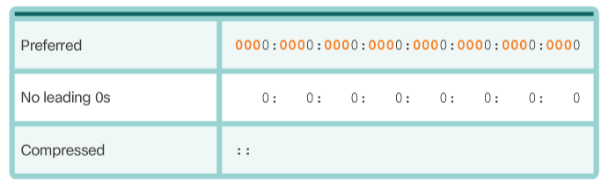
Cont’d…

Slide 67
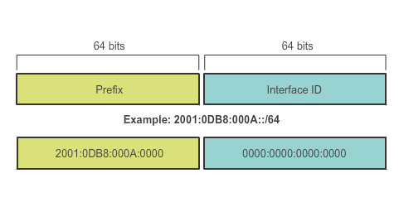
IPv6 Prefix Length
IPv6 does not use the dotted-decimal subnet mask notation but prefix length
Prefix length indicates the network portion of an IPv6 address using slash notation (/) eg. /64, /96

Slide 68
IPv6 Address Types
IPv6 Addresses
Unicast
Multicast
Anycast
Global Unicast
Link-Local
Loopback
Unspecified
Unique Local
Embedded IPv4
2000::/3
FE80::/10
::1/128
::/128
FC00::/7
::/80
IPv6 does not have a “broadcast” address.

Slide 69
There are three types of IPv6 addresses:
Unicast Address
Represents a single network interface. Packets addressed to a unicast address are delivered to a single interface (one-to-one)
Multicast Address
Represent a group of hosts. Packets sent to this address are delivered to all interfaces that have joined the corresponding multicast group (one-to-many)
Anycast Address
Represent one or more interfaces. Packets sent to that IP address are forwarded to the nearest server. Anycast addresses are used for load-balancing. Known as “one-to-nearest” address.
Note: IPv6 does not have broadcast addresses.

Slide 70
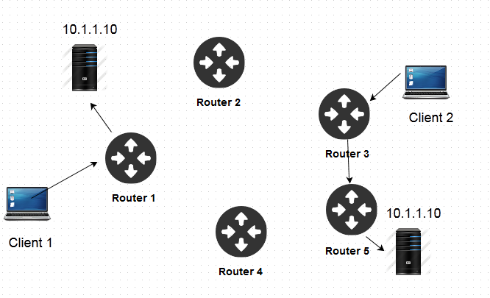
A single anycast address (10.1.1.10) is assigned to multiple hosts providing the service.
A sender will send a request with the anycast address in it packet header and the router will check the available receivers and deliver it to the nearest location.
https://www.slashroot.in

Slide 71
IPv6 Unicast Addresses
Common types of IPv6 unicast address:
Global Unicast Address (GUA)
Similar to a public IPv4 address.
Globally unique, Internet routable addresses.
Prefix range of 2000::/3 to 3FFF::/3
Link-local Address (LLA)
Used to communicate with other devices on the same local link (subnet)
Confined to a single link - not routable beyond the link
Every IPv6-enabled network interface is REQUIRED to have a link-local address
Prefix range of FE80::/10 to FE8F::/10
Unique local Address (ULA)
Similar to private addresses for IPv4
Used for local addressing within a site or between a limited number of sites – can be routed but within one routing domain
Prefix range of FC00::/7 to FDFF::/7

Slide 72
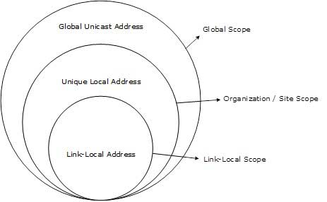
Scope of GUA, ULA and Link Local
https://www.tutorialspoint.com

Slide 73
Cont’d…
Loopback
Similar to IPv4 loopback address
Represented as ::1/128 or just ::1
Unspecified address
An unspecified address is used when the device does not yet have a permanent IPv6 address
All-0’s address represented as ::/128 or just ::

Slide 74
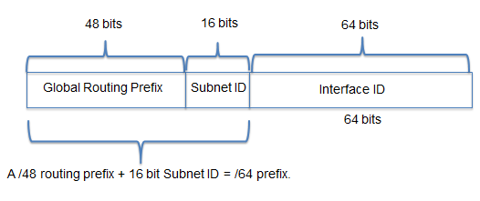
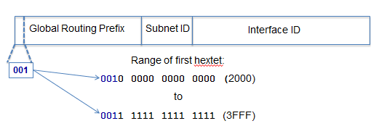
Structure of GUA
A global unicast address has three parts:

Slide 75
Cont’d…
Global Routing Prefix
Prefix or network, portion of the address that is assigned by the provider, such as an ISP, to a customer or site.
Typically /48
Subnet ID
Used by an organization to identify subnets within its site
Interface ID
Equivalent to the host portion of an IPv4 address
Used because a single host may have multiple interfaces, each having one or more IPv6 addresses

Slide 76
Chapter Summary
Structure of IPv4 address
Decimal ← → Binary conversion
Subnet Mask
Determine the network portion and host address
AND operation
IPv4 Unicast, Broadcast, Multicast
Types of IPv4 addresses
Types of networks (Class A, Class B, Class C)

Slide 77
Cont’d…
Migration techniques
IPv6 Unicast, Multicast and Anycast
IPv6 compression techniques
Types of IPv6 addresses

